Slide 1
International Business Environments & Operations
15e
Daniels ● Radebaugh ● Sullivan
PPT files revised and edited by
Prof. Romie Frederick Littrell
NRU-HSE-SPb
Notes:
International Business Environments and Operations 15e by Daniels, Radebaugh, and Sullivan

Slide 2
Prof. Romie Littrell- Who am I?
PhD Industrial and Organizational Psychology – Auckland University of Technology, New Zealand
PhD Business Administration, Kennedy College, Zurich, Switzerland
MBA, California Coast University, Santa Ana, California, USA
BA Psychology, University of Arkansas at Fayetteville, USA

Slide 3
Prof. Romie Littrell- Who am I?
Industry experience:
Graduate Assistant Consultant: The University of Texas at Austin: computer programming and statistical analysis
LTV Aerospace Corp., Dallas, Texas: Operations Research Analyst: computer system performance simulation
UNIVAC/Unisys, Atlanta, Georgia: Regional Staff: Large systems benchmark manager
Software Design, Inc., Atlanta, Georgia: marketing representative for large systems support software

Slide 4
Prof. Romie Littrell- Who am I?
Industry experience:, continued:
Olivetti/Docutel: Atlanta, Georgia: Communications Systems Engineer for Docutel automatic teller machine systems (ATM, Bancomat)
IBM, Orlando, Florida: marketing and systems support, Computer Integrated Manufacturing Specialist at Kennedy Space Center, Florida
Owner and manager of a small business marketing industrial computer products, Orlando, Florida
Human Resource Manager, InterContinental Hotels Group, Zhengzhou, China

Slide 5
Prof. Romie Littrell- Who am I?
University professor:
Glion Swiss Hotel School, Leysin, Switzerland
Hochscule Aalen and Ostalb Graduate Centre, Aalen, Baden-Wuerttemberg, Germany
Auckland University of Technology, Auckland, New Zealand
NRU-HSE-SPb

Slide 6
Prof. Romie Littrell- Who am I?
Visiting Professor:
Sheng Da Institute of Trade & Commerce, Zhenzhou University, Zengzhou, China
Sun Yat-sen University, Guangzhou, China
Dalian Nationalities University, China
IILM Institute for Higher Education, Lodhi Road, New Delhi, India
Izmir Economics University, Izmir, Turkey

Slide 7
Prof. Romie Littrell- Who am I?
Research specialties:
Business & Culture
Leadership across cultures
Management across cultures
International Human Resource Management
Most aspects of International Business
International marketing

Slide 8
Chapter 1
Globalization and International Business
Notes:
Chapter 18: Global Manufacturing and Supply-Chain Management

Slide 9
Objectives: After studying this chapter you should be able to
Define globalization and international business and explain how they affect each other
List reasons companies engage in international business and explain why its growth has accelerated
Discuss globalization’s future and the major criticisms of it
Explain and provide examples of the different ways a company can accomplish global objectives
Explain the need to apply social science discipline techniques to understand how international and domestic business differ

Slide 10
Learning Objectives
Describe the different dimensions of a global manufacturing strategy
List and explain the critical factors in successful global supply-chain management
Explain how supplier networks function
Explain how quality affects global supply and effective inventory management
Discuss how to establish successful transportation networks as part of the global supply chain
Notes:
The Learning Objectives for this chapter are:
To describe the different dimensions of a global manufacturing strategy
To examine the elements of global supply-chain management
To show how supplier networks function
To describe how information technology is critical to an effective global supply-chain strategy
To explain how quality affects global supply and effective inventory management
To discuss how to establish successful transportation networks as part of the global supply chain

Slide 11
Know thyself
https://en.wikipedia.org/wiki/Know_thyself

Slide 12
Doing business in Russia
https://hbr.org/2017/05/navigating-the-complexities-of-doing-business-in-russia
http://www.tmf-group.com/en/news-insights/business-culture/top-challenges-russia/
TMF Group provides consulting in doing business in various countries. It was founded in the Netherlands in 1988. Over the next 20 years it expanded rapidly across the world culminating in 2011 in its merger with Equity Trust, an established global leader in trust and fiduciary services. Today TMF Group operates in more than 120 offices in over 80 countries

Slide 13
Top 10 challenges of doing business in Russia-Disclaimer: This article was accurate at the time of publishing. To obtain the most up-to-date information, please get in touch with TMF’s local experts.
After years of subdued expectations there is an air of confidence surrounding the Russian economy as it pairs its economic potential with economic growth. But regardless of the positive strides it has made, many challenges to doing business in this diverse and notoriously tricky economy still remain.
Traditionally regarded as a resource-reliant economy, notable growth in retail, telecommunications and real estate development in recent years has driven an expansion in the country’s consumer base.
Incomes are increasing and consumer lending is also becoming more widespread, which has allowed the country to weather the economic storm far better than other export-reliant nations.
As the market matures and open market policies are favoured over a protectionist stance, the international business community is starting to warm to Russia as an investment destination. However, the obstacles are difficult to overcome without local help

Slide 14
Top 10 challenges of doing business in Russia: Starting a business
According to a report by the World Bank and International Finance Corporation (IFC), it takes an average of nine procedures and over 23 days to start a business in Russia. What’s more, it costs on average 2.3% of income per capita, with Surgut found to be the hardest place to start a business and St Petersburg ranked the easiest.
Construction permits
The number of steps needed to acquire construction permits can vary significantly from city to city; Novosibirsk requires only 16 compared to 47 in Moscow. As a result, there is huge variation in the time it takes to acquire permits; a year in Moscow compared to five months in Surgut.

Slide 15
Top 10 challenges of doing business in Russia: Starting a business
Registering property
Registering property is relatively cheap in Russia, and registration fees are among the lowest in the world and well below the OECD average. However, it still requires an average of four procedures and over 35 days to complete the procedure.
Getting electricity
Getting electricity is an extremely laborious task in Russia and firms can wait between four months and a year to get switched on, depending on the location. Design approval is a particularly complicated step, requiring several trips to public agencies and taking anything from 30 to 120 days.

Slide 16
Top 10 challenges of doing business in Russia: Starting a business
Punctuality
Businesses often find Russia’s polychronic culture - where attitudes to punctuality are a little more relaxed - hard to grow accustomed to. Many meetings will not conform to linear agendas used in other nations, which can disrupt inter-business communications.
Undeveloped infrastructure
Russia’s infrastructure is heavily Moscow-centred, with most transport channels of economic significance emanating from the country’s capital. Commercial transportation is heavily reliant on rail, although it is insufficiently integrated into world transport systems. For such a large nation, air links are still underdeveloped, making inter-country travel arduous.

Slide 17
Top 10 challenges of doing business in Russia: Starting a business
Intellectual property rights
Establishing intellectual property rights in Russia is still a tiresome business, although steps have been taken to simplify the process. As of 1 February 2013, a specialised court for intellectual property rights has been instituted within the commercial courts of the Russian Federation.
Government transparency
Government transparency is a problem in Russia, although the situation has improved significantly. The Open Budget Survey 2012 conducted by the International Budget Partnership found Russia has significantly improved its budget transparency over the years and is now telling its public more about government income and spending than countries such as Germany or Spain.

Slide 18
Top 10 challenges of doing business in Russia: Starting a business
Government interference
Ruben Vardanyan, head of Troika Dialogue Group, described Russia’s main challenges as being corruption, government interference and the high level of monopolisation. Although steps have been made to amend problems in central government, overseas firms still find the state of governance in Russia difficult to navigate.
Protectionism
An EU report revealed a “staggering increase” in protectionist measures as governments seek to shield national industries from foreign competition amid a difficult economic environment. Russia was among the worst offenders; the report concluded that Moscow was not in compliance with its future obligations to the World Trade Organization.

Slide 19
Russia—International Trade
Export Partners (2015)
Import Partners (2015)
Netherlands 11.9%
China 8.3%
Germany 7.4%
Italy 6.5%
Turkey 5.6%
Belarus 4.4%
Japan 4.2%
China 19.2%
Germany 11.2%
US 6.4%
Belarus 4.8%,
Italy 4.6%

Slide 20
18 October 2017
Russia's Trade With China Up 22%
https://themoscowtimes.com/articles/russias-trade-with-china-up-22-to-59285

Slide 21
Introduction
Globalization is the widening set of interdependent relationships among people from different parts of a world divided into nations
The term sometimes refers to the elimination of barriers to international movement of goods, services, capital, technology, and people that influence the integration of world economies
Notes:
What is globalization? Globalization refers to the widening set of interdependent relationships among people from different parts of a world that is divided into nations.
The term also refers to the integration of world economies through the reduction of barriers to the movement of trade, capital, technology, and people. Throughout history, human contacts over ever-wider geographic areas have expanded the variety of available resources, products, services, and markets.
Today, so many different components, ingredients, and specialized business activities go into products that we’re often challenged to say exactly where they were made. For example Apple’s iPhones are shipped from China and seem to be Chinese, yet less than four percent of their value is actually performed in China!

Slide 22
Short, pretty good discussion of basic advantages and disadvantages of globalization:
https://www.youtube.com/watch?v=i-eHj6bVU8w
Approx. 4 minutes

Slide 23
When did globalisation start?
Andre Gunder Frank, (February 24, 1929 – April 23, 2005) a German-American economic historian and sociologist: large-scale inter-civilization trade began with the rise of trade links between Sumer and the Indus Valley Civilization around 3000 BC.

Slide 24
When did globalization start?
U.S. journalist Thomas L. Friedman (not economist Milton Friedman) divides the history of globalization into three periods:
Globalization 1 (1492–1800), globalization of countries (the premise for this is the voyage of Columbus to the Americas);
Globalization 2 (1800–2000), globalization of companies;
Globalization 3 (2000–present), globalization of individuals.

Slide 25
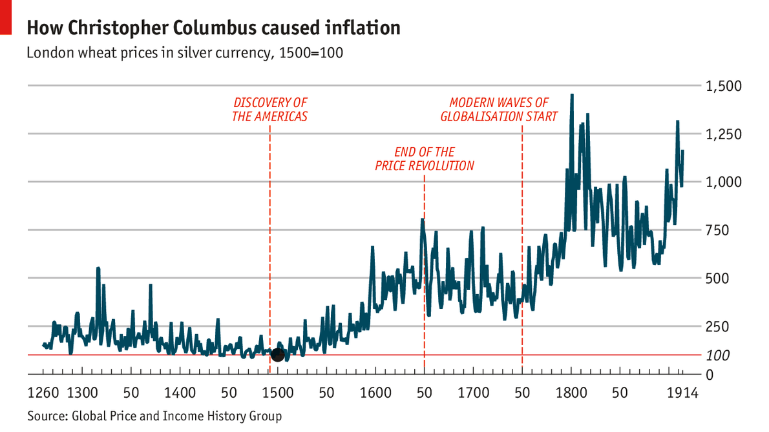
New World Silver and European Inflation

Slide 26
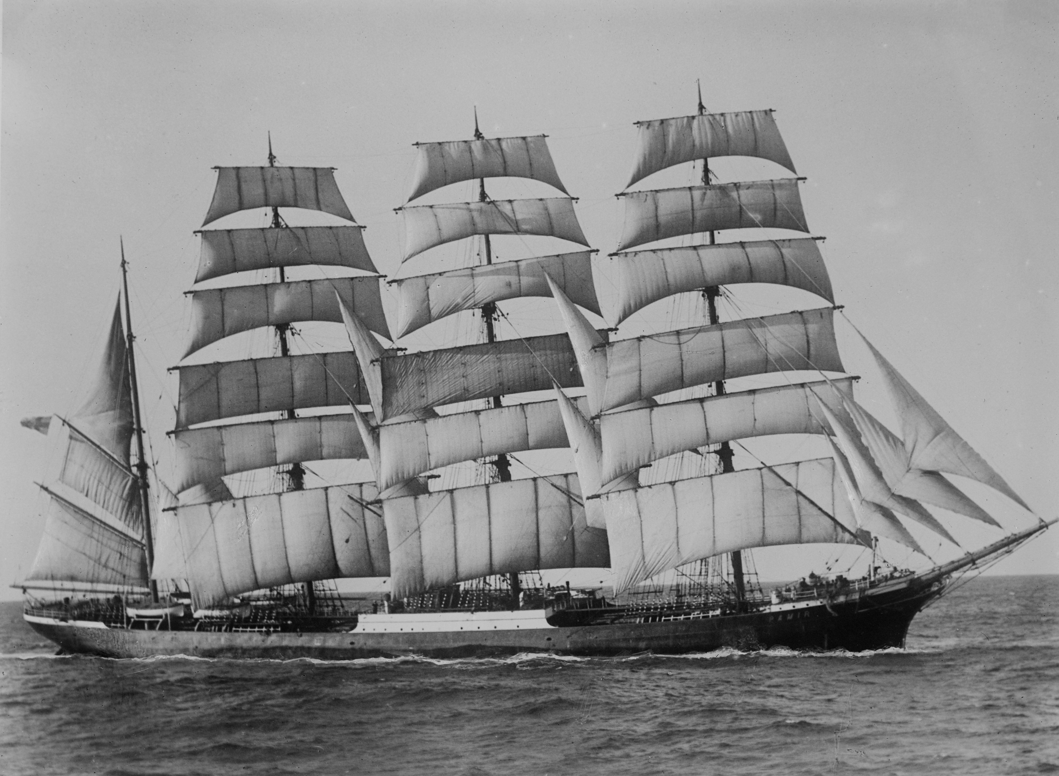
Globalization, Transportation Costs and Speed
American clippers reached 14 to 17 knots in the 1850s, with the fastest recording speeds of 22 knots or more (40 km/hr).

Slide 27
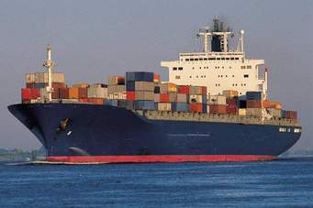
Globalization, Cost and Speed
Container ships (much larger than clippers, but use fuel oil rather than wind for propulsion): typical speed is 16–25 knots (30–46 km/h).

Slide 28
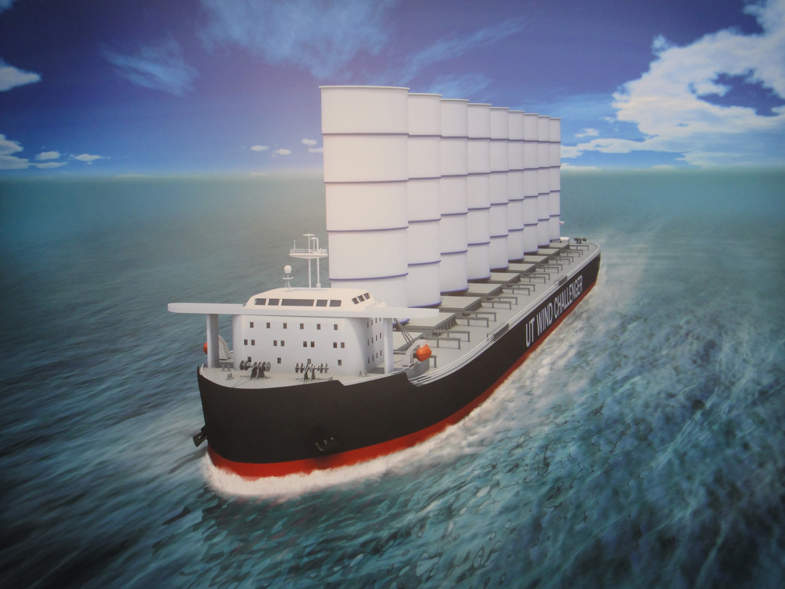
Globalization, Cost and Speed
University of Tokyo Windchallenger

Slide 29
University of Tokyo Windchallenger
The Wind Challenger Project which was started in 2009 by the University of Tokyo and the JIP includes NYK Line, Mitsui O.S.K. Lines, Ltd., Oshima Shipbuilding Co., Ltd., TADANO Ltd., ClassNK and TOKYO KEIKI INC.
he vessel is equipped with extraordinary large rigid sails (Height:50m, Breadth:20m, Thick:4m, Area:1,000m2) on the upper deck as a main propulsor which is made by advanced light material such as CFRP composite or Aluminum Alloy. This rigid sail whose horizontal section is crescent shape has a retractable steel spar and totally enclosed wing of composite material, and also has a vertically telescopic reefing and self-rotating mechanism to meet the wind velocity and direction. The four pieces of rigid sails (total sail area 4,000m²) are expected to generate forward thrust enough to drive 84,000DWT Bulk Carrier at the cruising speed of 14 knots, a bit slower than most ocean-going freighters.
The power management system between sails and a diesel engine is also studied in order to save fuel consumption of the vessel at the hybrid operation mode. http://wind.k.u-tokyo.ac.jp/project_en.html

Slide 30
Rail freight transport
Rank | Country | Billion tkm | Data year
1 | United States | 2,704 | 2014
2 | China | 2,375 | 2015
3 | Russia | 2,306 | 2015
In the USA For the first decade of the 21st century, freight train speed has varied between 32 and 37 kph, Russia: 60 to 90 kph, China: 35.6 kph
Air freight: 800 to 900 kph
Trucks: US interstate: 80 – 100 kph;
China: 20 to 40 kph;
Russia: long-distance national highway 80 kph.

Slide 31
Communication Speed
Prior to 1866 letters were delivered by the postal services between New York and London in about 2 weeks.
Reliable transatlantic telegraph was available and working from 1866, and within Europe and America, all major cities were connected by that time
By mid-1968, transatlantic cable capacity had increased to the point where scheduling telephone calls between Western Europe, the UK, and USA was no longer necessary and calls were completed on demand.
Transatlantic International Direct Dialing between New York City and London was introduced in 1970 with service extended to the whole of the USA and the 6 largest UK cities in 1971.

Slide 32
Rethinking Some Assumptions About Global Business
Companies may be profiting, but they're not investing those profits in long-term growth. For more, read "An Agenda for the Future of Global Business."
APRIL 10, 2017
1:59 min.
https://hbr.org/video/5392487464001/rethinking-some-assumptions-about-global-business

Slide 33
Introduction – International Business
Business transactions that involve crossing international borders.
International business consists of all commercial transactions—including sales, investments, and transportation—that take place between two or more countries
increasingly foreign countries are a source of both production and sales for initially domestic-only companies
Notes:
What is international business? International business consists of all commercial transactions that take place between two or more countries. International business activities allow us to get more variety, better quality, and/or lower prices.
International business activities may be performed by private companies motivated by profit, or by governments that undertake them either for profit or for political reasons.

Slide 34
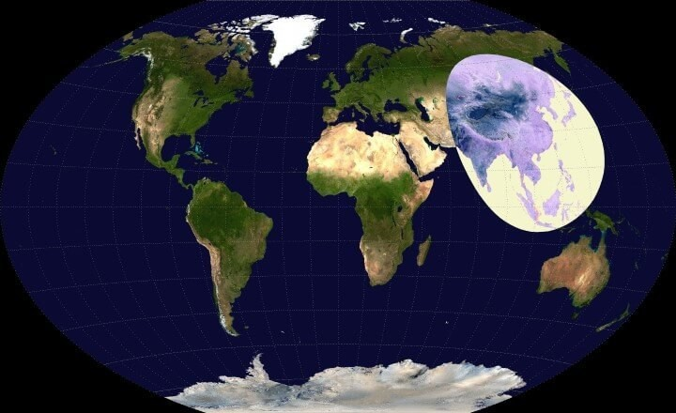
Labour and production costs: More people live inside this area than outside it.

Slide 35
Moving things around
Supply-chain management refers to activities in the value chain that occur outside the company,
whereas operations management (also known as logistics management) often refers to internal activities.
Logistics (also called materials management)—that part of the supply-chain process that plans, implements, and controls the efficient, effective flow and storage of goods, services, and related information from the point of origin to the point of consumption in order to meet customers’ requirements.

Slide 36
Globalization & Supply Chain Management
Effective supply chain management
reduces costs
increases revenue
Notes:
Effective supply chain management is one of the most important tools companies have to reduce costs and increase revenue.

Slide 37
What is Supply-Chain Management?
The supply chain
the network that links together the different aspects of the value chain, coordinating materials, information, and funds from the initial raw material supplier to the ultimate customer
Supply chain management aka operations and supply-chain management (OSM)
the design, operation, and improvement of systems that create and deliver the firm’s primary products and services
Notes:
Supply chain management refers to everything from creating supplier relationships to getting the product to the final consumer.

Slide 38
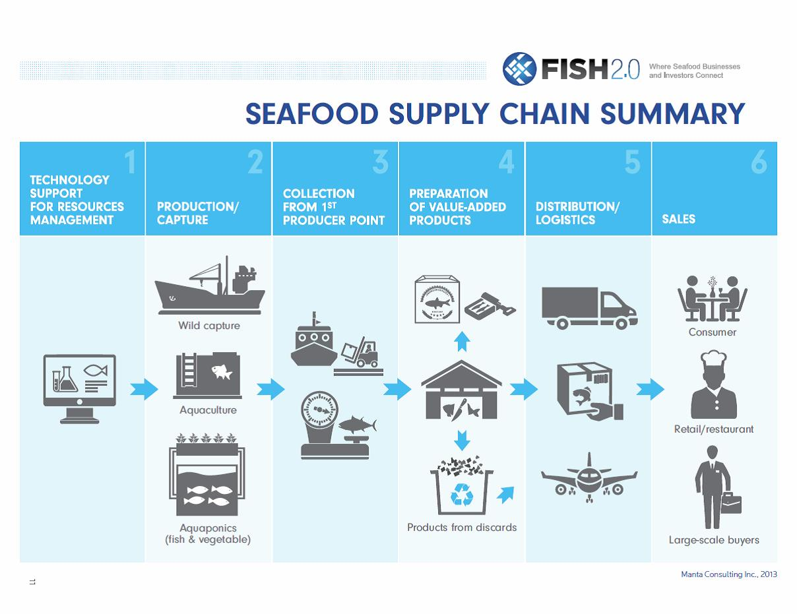

Slide 39
An integrated supply chain and operations model
Notes:
This illustration shows a generic industry supply chain of a firm

Slide 40
Global Supply Chain Strategies
Factors in supply chain strategy
Compatibility
Manufacturing Configuration
Coordination
Control
Notes:
Four key factors influence the success of a company’s global manufacturing strategy.
The first, compatibility, refers to the degree of consistency between the foreign investment decision and the company’s competitive strategy.
The second, manufacturing configuration, requires the company to consider whether to centralize manufacturing in one country, establish regional operations, or set up multidomestic production.
Third, coordination involves integrating activities into a unified system.
Finally, control involves measuring performance so the company can respond appropriately to changing conditions.

Slide 41
Supplier Networks
Learning Objective
Show how supplier networks function
Notes:
Learning Objective
To show how supplier networks function

Slide 42
Supplier Networks
Sourcing is the process of obtaining a supply of inputs (raw materials and parts) for production.
Global sourcing is the process of materials management (which includes sourcing), inventory management, and transportation between suppliers, manufacturers and customers.
Notes:
Sourcing is the process of obtaining a supply of inputs (raw materials and parts) for production.
Global sourcing is the process of materials management (which includes sourcing), inventory management, and transportation between suppliers, manufacturers and customers.

Slide 43
Global Sourcing
Notes:
This illustration shows how sourcing is important in different aspects of business

Slide 44
Global Sourcing
Outsourcing is when a company externalizes a function or process to another business.
Contract Manufacturing is when the entire manufacturing process is being handled by another firm.
Notes:
Outsourcing is when a company externalizes a function or process to another business.
is when the entire manufacturing process is being handled by another firm.
Contract Manufacturing

Slide 45
Why Global Sourcing?
To reduce costs through cheaper labor, laxer work rules, and low land and facilities costs
To improve quality
To increase exposure to worldwide technology
To improve the delivery-of-supplies process
Notes:
Companies engage in global sourcing for the following reasons:
To reduce costs through cheaper labor, laxer work rules, and low land and facilities costs
To improve quality
To increase exposure to worldwide technology
To improve the delivery-of-supplies process

Slide 46
Why Global Sourcing?
To strengthen reliability of supply – supplementing domestic suppliers with foreign ones
To gain access to materials that are only available abroad
To establish presence in a foreign market
To satisfy offset requirements
To react to competitors’ offshore sourcing practices
Notes:
Also…
To strengthen reliability of supply – supplementing domestic suppliers with foreign ones
To gain access to materials that are only available abroad
To establish presence in a foreign market
To satisfy offset requirements
To react to competitors’ offshore sourcing practices

Slide 47
Global Sourcing
Vertical Integration is when a company owns the entire supplier network, or at least a significant part of it.
Industrial Clusters occur when buyers and suppliers locate close to each other to facilitate doing business.
Dell Computer in Malaysia
Keiretsu – Japanese group of independent companies that work together to manage the flow of goods
Notes:
Vertical Integration is when a company owns the entire supplier network, or at least a significant part of it.
Industrial Clusters occur when buyers and suppliers locate close to each other to facilitate doing business, for example Dell Computer in Malaysia.
A Keiretsu is a Japanese group of independent companies that work together to manage the flow of goods

Slide 48
Global Supply Chain Management Requires High Speed, Accessible Communications
Foreign Policy magazine: “China is trying to give the Internet a death blow”:
http://foreignpolicy.com/2017/08/25/china-is-trying-to-give-the-internet-a-death-blow-vpn-technology/

Slide 49
The Make-or-Buy Decision
Which production activities should take place in-house and which should be subcontracted to independent companies?
Notes:
The make-or-buy decision involves deciding which activities should take place in-house and which should be subcontracted to outside companies either domestic or foreign.

Slide 50
Supplier Relations
Firms that outsource must decide
How to work with suppliers
Close arrangement
Trust
Arms-length
Notes:
Companies that outsource must also develop a relationship with their suppliers. Some companies approach this relationship like a partnership, while others take more of an arms-length approach.
Note that closer relationships require a great deal of trust, but can offer strategic advantages.

Slide 51
The Purchasing Function
Four phases of purchasing
Domestic purchasing only
Foreign buying based on need
Foreign buying as part of a procurement strategy
Integration of global procurement strategy
Notes:
Purchasing typically goes through four phases before it becomes ‘global’: domestic purchasing only; foreign buying based on need; foreign buying as part of procurement strategy; and integration of global procurement strategy.

Slide 52
Information Technology and Global Supply-Chain Management
Electronic Data Interchange
links suppliers, manufacturers, customers, and intermediaries
Enterprise Resource Planning/Material Requirements Planning
links information flows from different parts of a business and from different geographic areas
Radio Frequency ID (RFID)
labels products with an electronic tag, which stores and transmits information regarding the product’s origin, destination, and quantity
E-Commerce
joins together suppliers with companies and companies with customers
Notes:
The key to making a global information system work is getting the relevant information in a timely manner. Information technology is essential to this process. There are several technologies that can facilitate information flows and business including electronic data interchange, enterprise resource planning/material requirements planning, radio frequency ID, and e-commerce.

Slide 53
AIB Insights
Special issue focused on the process of reshoring or backshoring.
https://aib.msu.edu/publications/insights/volume/15/issue/4

Slide 54
Quality
Learning Objective:
Explain how quality affects the global supply and effective inventory management
Notes:
Learning Objective : To show how quality affects the global supply chain.

Slide 55
Quality
Quality
meeting or exceeding customer expectations
involves careful design of a product or service and ensuring that the organization’s systems can consistently produce the design
Notes:
Quality management is an important issues at all levels of the global supply chain.

Slide 56
Zero Defects versus Acceptable Quality Level
Zero defects
no flaws of any kind
Acceptable quality level (AQL)
a few unacceptable products would be dealt with through repair facilities and service warranties
Notes:
Many companies today take a zero defects approach to quality. In fact, a zero defects approach, an idea perfected by Japanese manufacturers, may be necessary to beat the competition.

Slide 57
The Deming Approach to Quality Management
William Edwards Deming (October 14, 1900 – December 20, 1993) n American engineer, statistician, professor, author, lecturer, and management consultant, major book: The New Economics for Industry, Government, and Education
Also see:
https://en.wikipedia.org/wiki/W._Edwards_Deming
Notes:
In the late 1970s, W. Edwards Deming promoted quality using his 14 Point plan to reduce variance in manufacturing.
Deming’s approach to quality was initially adopted by the Japanese but has since spread to other countries.

Slide 58
Deming’s 14 points on Quality Management— Managers are responsible for quality
Create constancy of purpose for improving products and services.
All must adopt the new philosophy.
Cease dependence on inspection to achieve quality.
End the practice of awarding business on price alone; instead, minimize total cost by working with a single supplier.
Improve constantly and forever every process for planning, production and service.
Institute training on the job.
Managers must also be leaders.
Drive out fear.
Break down barriers between staff areas.
Notes:
In the late 1970s, W. Edwards Deming promoted quality using his 14 Point plan to reduce variance in manufacturing.
Deming’s approach to quality was initially adopted by the Japanese but has since spread to other countries.

Slide 59
Deming’s 14 points on Quality Management— Managers are responsible for quality
Eliminate slogans, exhortations and targets for the workforce.
Eliminate numerical quotas for the workforce and numerical goals for management.
Remove barriers that rob people of pride of workmanship, and eliminate the annual rating or merit system.
Institute a vigorous program of education and self-improvement for everyone.
Put everybody in the company to work accomplishing the transformation.
Notes:
In the late 1970s, W. Edwards Deming promoted quality using his 14 Point plan to reduce variance in manufacturing.
Deming’s approach to quality was initially adopted by the Japanese but has since spread to other countries.

Slide 60
Total Quality Management
Total quality management (TQM)
a process that stresses three principles
customer satisfaction
continuous improvement
employee involvement
Notes:
The TQM process, perfected by the Japanese, is focused on customer satisfaction, continuous improvement, and employee involvement. The ultimate goal is to eliminate all defects.

Slide 61
Six Sigma
Six sigma (99.9997% defect-free)
aims to eliminate defects, slash product cycle times, and cut costs across the board
Notes:
Motorola developed the Six Sigma approach to quality management in the 1980s. Since then, it has been adopted by many multinationals, notably General Electric.

Slide 62
Quality Standards
Levels of quality standards
General
ISO 9000
Malcom Baldridge National Quality Award
Industry specific
Company specific
Notes:
Companies that meet general levels of quality assurance focus on the International Organization for Standardization (ISO) standards including ISO 9000 which is a global set of quality standards designed to promote quality at every level of an organization.
The ISO 4000 standards focus on environmental management.
Meeting ISO standards can be essential to business. Non-European companies operating in Europe, for example, must be ISO certified.
In addition to these general standards, most companies also strive to meet industry level and company specific standards of quality.

Slide 63
Inventory Management
Learning Objective:
Explain how quality affects global supply and effective inventory management
Notes:
Learning Objective : To explain how inventory management is a key dimension of the global supply chain.

Slide 64
Inventory Management
Lean manufacturing
a productive system whose focus is on optimizing processes through the philosophy of continual improvement
Just-in-time (JIT) inventory management
focuses on reducing inefficiency and unproductive time in the production process to improve continuously the process and the quality of the product or service
Notes:
Companies that source internationally may find that inventory flows are complicated by time, distance, and uncertainty.
Lean manufacturing and JIT systems can be more difficult to implement when foreign suppliers are involved.

Slide 65
Foreign Trade Zones
Foreign trade zones (FTZs)
areas in which domestic and imported merchandise can be stored, inspected, and manufactured free from formal customs procedures until the goods leave the zones
General purpose
Subzones
Notes:
Foreign trade zones, of FTZs have become a common intermediate step in the process between import and final use. FTZs are attractive because they allow companies to defer duties, pay fewer duties, or avoid duties entirely.
General purpose zones are located near shipping ports, airports, or border crossings.
Subzones are often located at a manufacturing facility.

Slide 66
Transportation Networks
Learning Objective:
Discuss how to establish successful transportation networks as part of the global supply chain
Notes:
Learning Objective:
To discuss how to establish successful transportation networks as part of the global supply chain

Slide 67
Transportation Networks
Transportation links
Suppliers
Companies
Customers
Notes:
Transportation is a crucial part of logistics. It links together suppliers, companies, and customers.

Slide 68
Uncertainty and the Global Supply Chain
Globalization encourages companies to outsource to foreign suppliers to reduce costs
But, political events increase the risk of supply chain disruption
Notes:
Globalization is pushing firms to establish operations in foreign locations as a means of lowering costs and being closer to markets. However, this means that the supply chain is longer, and consequently subject to more risk.

Slide 69
Other source(s)
http://www.globalization101.org/

Slide 70
All rights reserved. No part of this publication may be reproduced, stored in a retrieval system, or transmitted, in any form or by any means, electronic, mechanical, photocopying, recording, or otherwise, without the prior written permission of the publisher. Printed in the United States of America.

Slide 71
Case Study: New Balance
NEW BALANCE
From public sources:
16 Nov. 2016
“As the only major company that still makes athletic shoes in the U.S., New Balance has a unique perspective on trade in that we want to make more shoes in the U.S., not less,” the company said last week.
New Balance operates five factories in Massachusetts and Maine, where it manufactures or assembles more than 4 million pairs of shoes each year.

Slide 72
New News: One Belt, One Road
The Silk Road Economic Belt and the 21st-century Maritime Silk Road
Traditional Chinese | 絲綢之路經濟帶和21世紀海上絲綢之路
Simplified Chinese | 丝绸之路经济带和21世纪海上丝绸之路

Slide 73
The ‘silk road’ trade route from mainland China to the fringes of Europe
The ‘silk road’ trade route from mainland China to the fringes of Europe came about as early as 200bce but there are hints of it being far older.
Travelling some 7000 miles would have literally taken a year of travel on foot and by sail., making a round trip more than two years long.

Slide 74
Is this what it looked like?

Slide 75
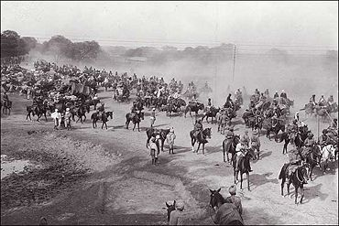
Probably Not: the Grand Trunk Road in India has served as the main artery for travel across Northern India for centuries. A scene from the Ambala cantonment, near Delhi, during the British Raj - source BBC

Slide 76
Importance of Monitoring the IB Environment: Economic globalisation After 4000 years
Globalisation poses the long-term potential to raise living standards and reduce the costs of goods and services for large numbers of people
The short-term marketplace consequences of free trade threaten many people and enterprises in both developed and developing nations with potentially insurmountable competition
For most people around the world, the threat from foreign competitors is regarded as much greater than the threat from foreign terrorists
Risk and uncertainty in daily life is characteristically high in developing countries
In developed economies, where formal institutions sustain a higher level of order and predictability, trade liberalization poses unfamiliar risks and uncertainties for many enterprises
In large developed economies, trade liberalisation appears to be affecting the collective psychology of both blue-collar and white-collar workers, especially males, who are increasingly unwilling to commit themselves to careers in fields that are likely to be subject to low-cost foreign competition

Slide 77
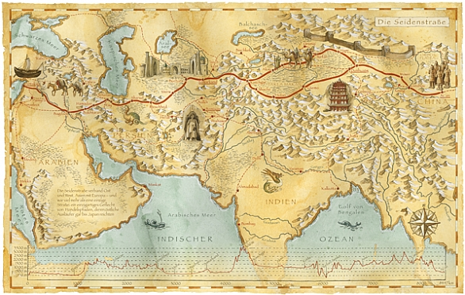
In 1877 the term "Seidenstraße" (Die Seidenstrassen, literally "Silk Road") was coined by the German geographer, cartographer and explorer Ferdinand von Richthofen.

Slide 78
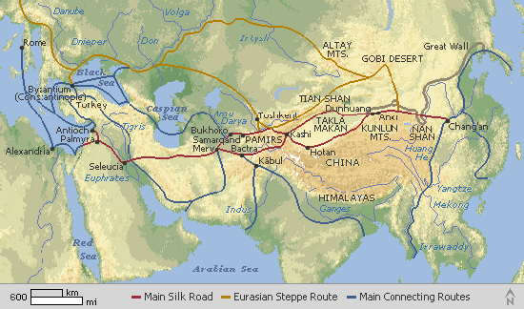
The Silk Road grew under the Chinese Han Dynasty (202 BC - AD 220) during the first and second centuries AD, and connected the Yellow River Valley of China to the Mediterranean Sea.

Slide 79
The Belt and Road initiative is geographically structured along 6 corridors, and the maritime silk road
New Eurasian Land Bridge, running from Western China to Western Russia
China–Mongolia–Russia Corridor, running from Northern China to Eastern Russia
China–Central Asia–West Asia Corridor, running from Western China to Turkey
China–Indochina Peninsula Corridor, running from Southern China to Singapore
China–Myanmar–Bangladesh–India Corridor, running from Southern China to Myanmar
China–Pakistan Corridor, running from South-Western China to Pakistan
Maritime Silk Road, running from the Chinese Coast through Singapore to the Mediterranean

Slide 80
The plan
https://www.clsa.com/special/onebeltoneroad/

Slide 81
Henry Kissinger
“nations do not have friends, only interests”
Kissinger was U.S. Secretary of State under President Richard Nixon, and awarded the Nobel Peace Prize.

Slide 82
Why China’s ‘Silk Road’ plan has spelt unease for India, US, Russia—China is probably not building it just to make friends.
http://www.hindustantimes.com/india-news/a-strategy-through-investments-why-china-s-silk-road-plan-has-spelt-unease-for-india-us-russia/story-oRsPwwV6J18gFGdqM4XdSM.html

